Slide 1
Classifying Cats: Exploring ML Models
Cat-pstone Project 2
Springboard Data Science Career Track Program

Slide 2
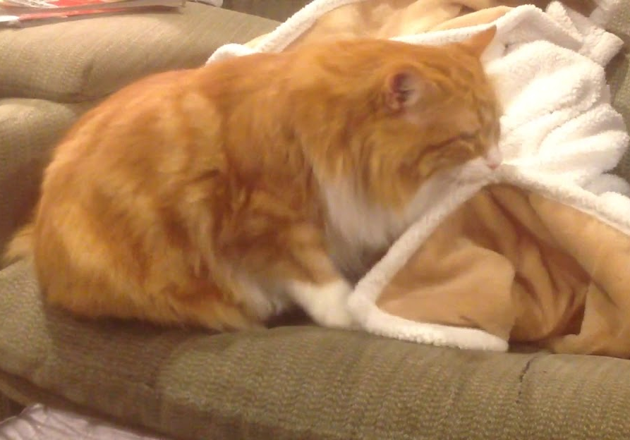
The goal
Catering to BuddyTheCat's growing demand, we've created a binary classification system to identify cats as "suckers" or "non-suckers."
Helps match individuals with feline companions that exhibit this adorable behavior.
Notes:
reminder: still want to classify cats as wool-suckers or non-suckers

Slide 3
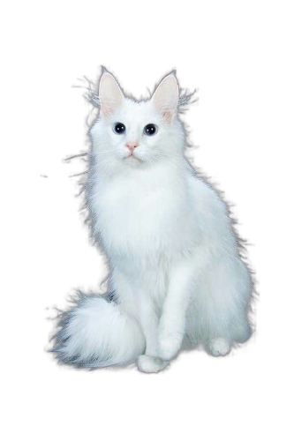
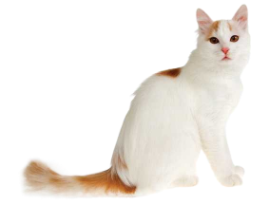
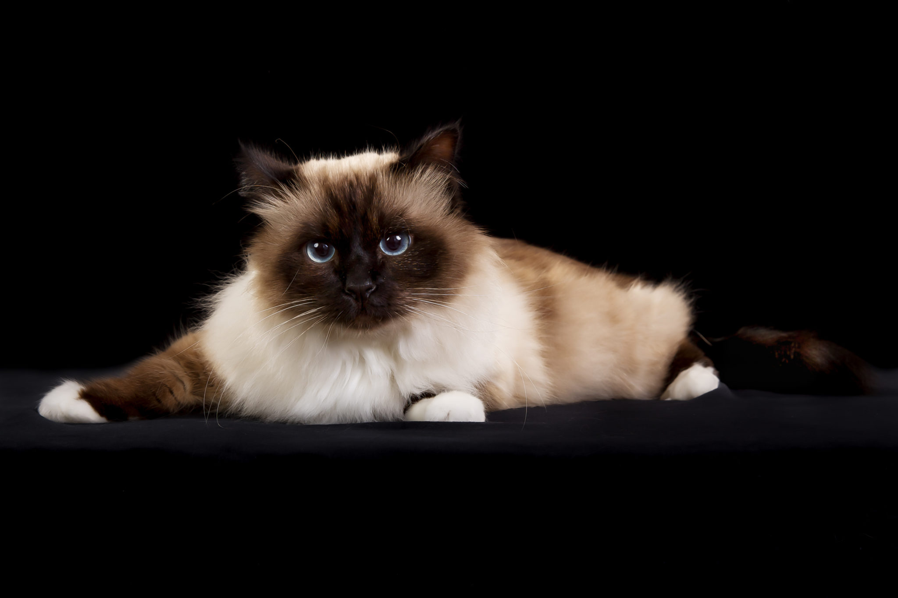
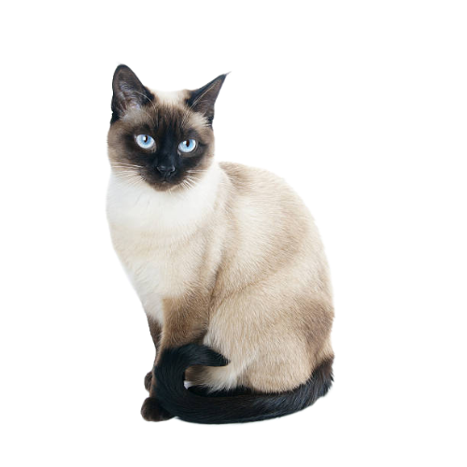
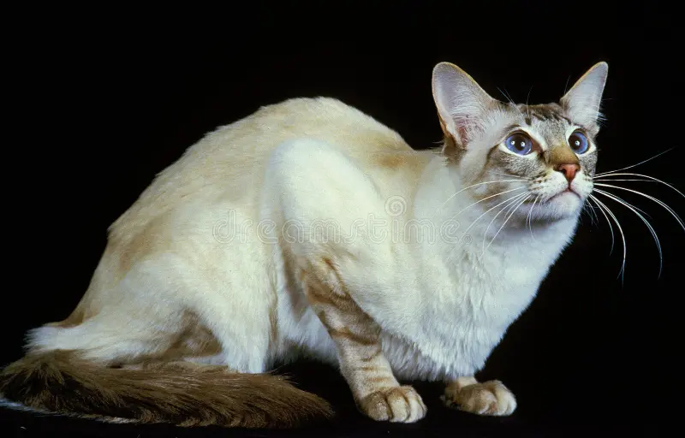
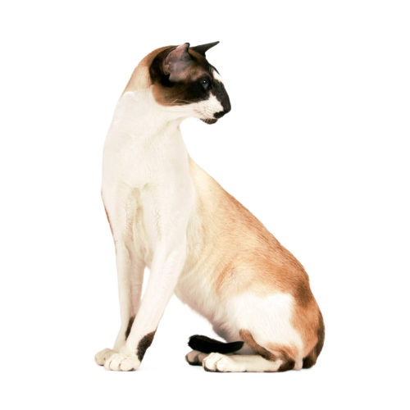
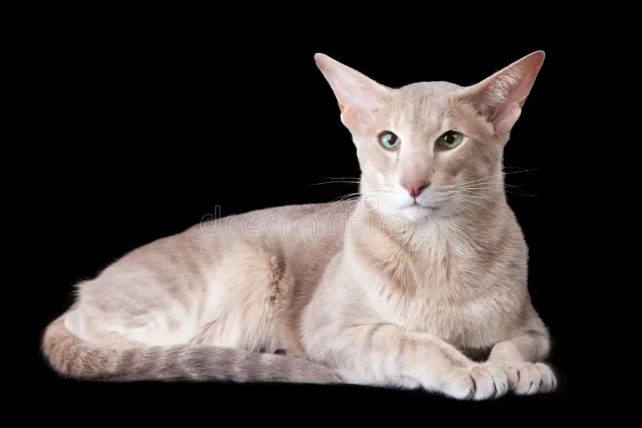
Cat-pstone 1 findings
Positive Predictive
Cat-pstone 1 used a logistic regression model with balanced class weights
Breed and excessive grooming were highly predictive
Turkish Van, Angora
Saint Birman
Balinese, Oriental L/S, Seychellois L/S, Siamese
Notes:
In Cat-pstone 1, we leveraged a logistic regression model with balanced class weights to address the class imbalance in the target feature.
Notably, we discovered that both breed and excessive grooming emerged as highly predictive factors in the model.

Slide 4
Cat-pstone 2
Is deep learning really better than a more simple supervised ML model?

Slide 5
WHAT IS DEEP LEARNING?

Slide 6
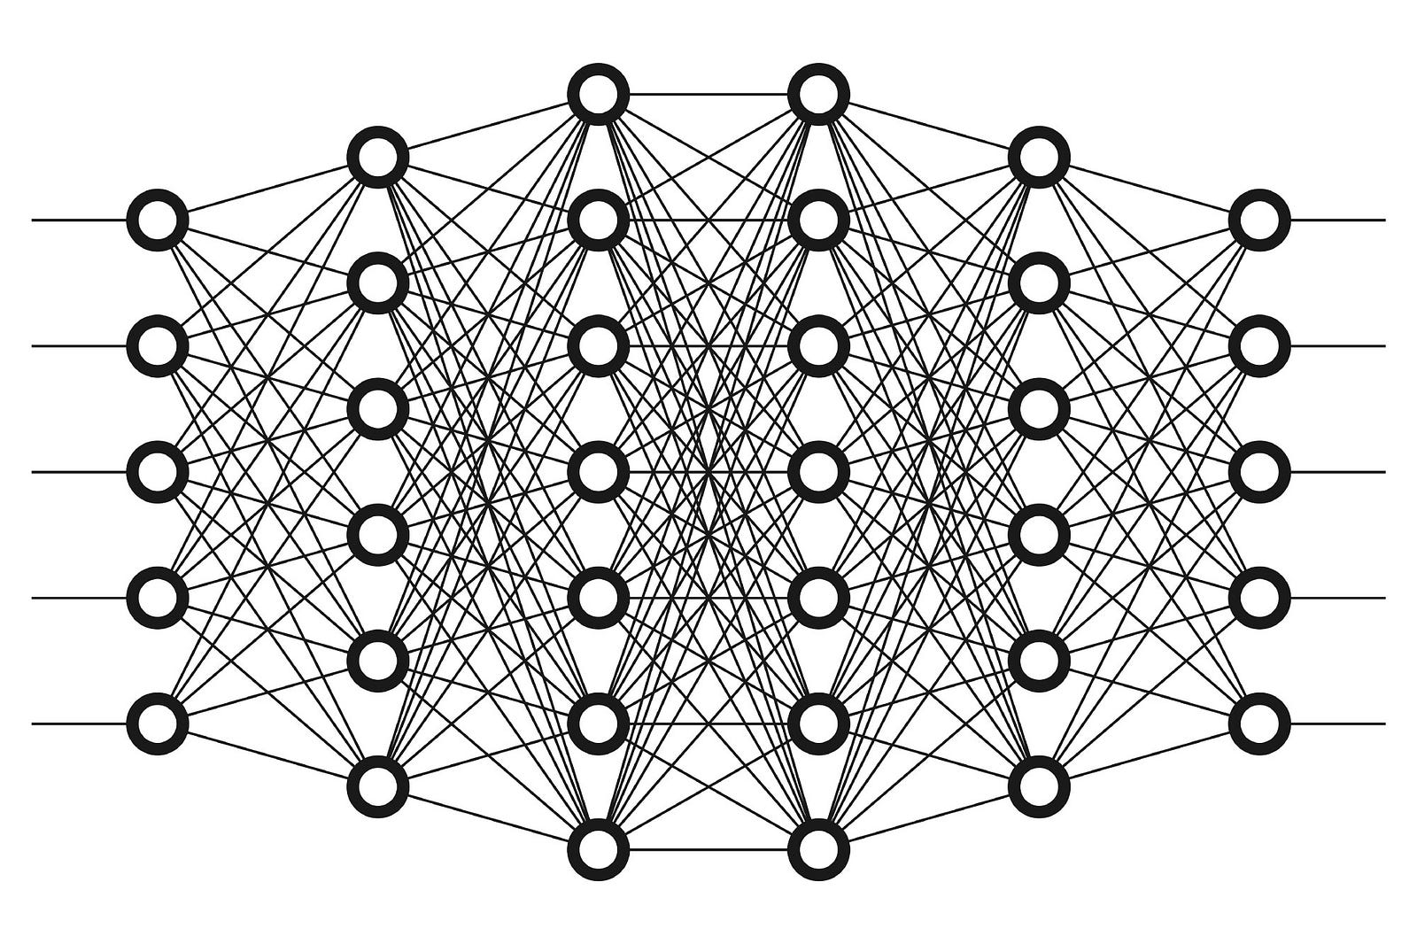
WHAT IS DEEP LEARNING
Subfield of machine learning
Neural networks with multiple layers
Automatic learning and hierarchical data representation extraction

Slide 7
WHY DEEP LEARNING

Slide 8
WHY DEEP LEARNING
PROS
Captures more complex hierarchical patterns
Can learn directly without extensive feature engineering
Can handle non-linear relationships
CONS
Requires more computational resources
Less efficient
Less interpretability
Notes:
MLP Model:
Pro: Captures complex patterns and hierarchical relationships in data.
Pro: Ability to handle non-linear relationships.
Pro: Can learn directly from raw data without extensive feature engineering.
Con: Requires more computational resources and longer training times.
Con: More complex architecture may be harder to interpret.
Logistic Regression Model:
Pro: Simplicity and interpretability.
Pro: Efficient training and prediction times.
Pro: Performs well with small datasets and linear relationships.
Con: Limited ability to capture complex patterns and non-linear relationships.
Con: Relies on explicit feature engineering.

Slide 9
PREPPING THE DATA

Slide 10
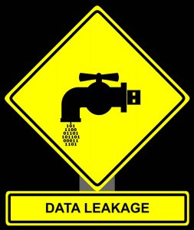
PREPPING THE DATA: Imputing without Leakage
Cat-pstone 1: Imputation of missing data used entire dataset, which could result in minor data leakage.
Cat-pstone 2: Imputed missing data exclusively within the training set to maintain data integrity.
Notes:
Ensured no bias from test set and eliminated potential data leakage.

Slide 11
PREPPING THE DATA: Feature selection
Breed Group (One-hot encoded)
Neuter Status
(Excessive) Grooming
Shyness Novel
Shyness Strangers
Aggression Owners
Aggression Cats
Behavior Problem
Aggression Strangers
Outdoors
Contact People
Age
Activity Level
Other Cats
Gender

Slide 12
PREPPING THE DATA: Feature selection
Breed Group (One-hot encoded)
Neuter Status
(Excessive) Grooming
Shyness Novel
Shyness Strangers
Aggression Owners
Aggression Cats
Behavior Problem
Aggression Strangers
Outdoors
Contact People
Age
Activity Level
Other Cats
Gender

Slide 13
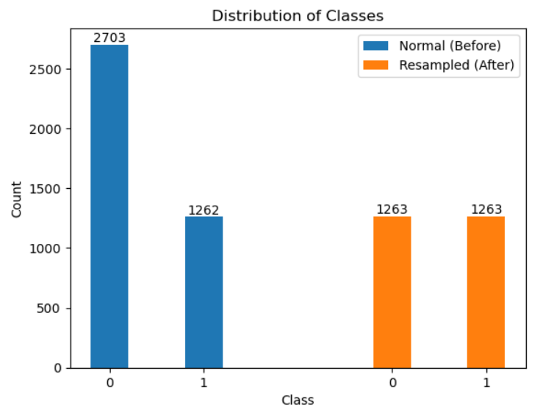
PREPPING THE DATA: Resampling

Slide 14
DEEP LEARNING MODEL SELECTION

Slide 15
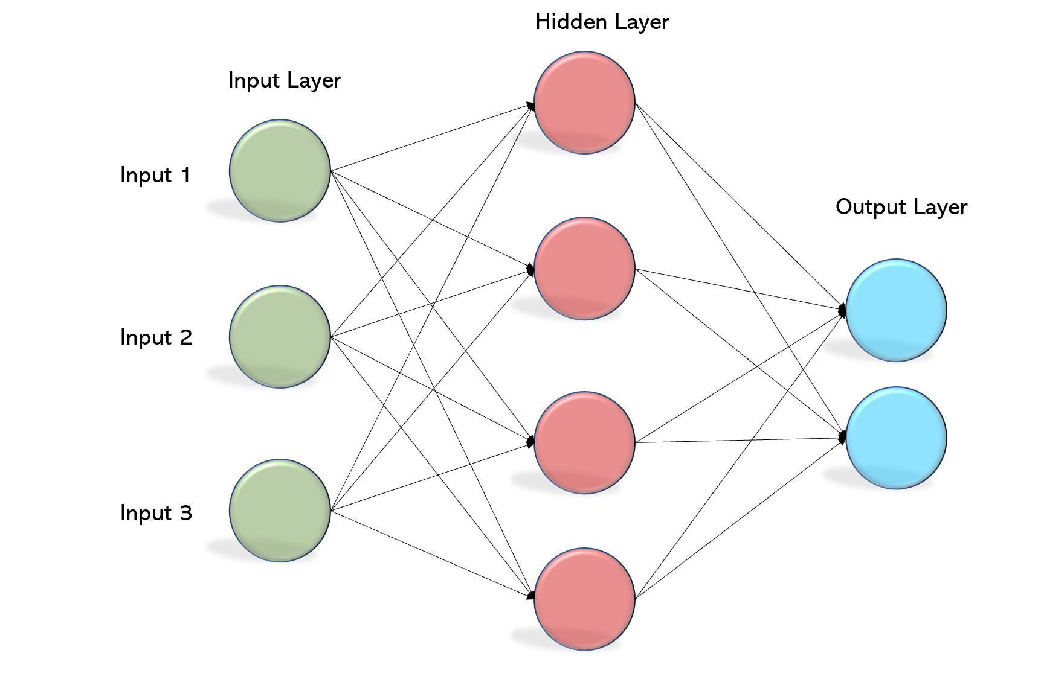
DEEP LEARNING MODEL SELECTION: MLP
Multilayer Perceptron (MLP)
Flexible and adaptable, even with small datasets
Multilayer design allows for hierarchical learning
Notes:
An MLP (Multilayer Perceptron) model is a type of deep learning algorithm that consists of multiple layers of interconnected artificial neurons. It is good for binary classification with a small dataset due to the following reasons:
MLP can effectively capture complex patterns and relationships within the data, enabling it to learn from limited samples and make accurate predictions.
The flexibility of MLP allows it to adapt and generalize well to binary classification tasks, even with small datasets, making it suitable for extracting meaningful insights.
By leveraging multiple layers, MLP can learn hierarchical representations of the data, automatically extracting relevant features without the need for extensive feature engineering, which is especially beneficial when dealing with limited data.

Slide 16
LOGISTIC REGRESSION VS MLP
(spoiler: they perform very similarly)

Slide 17
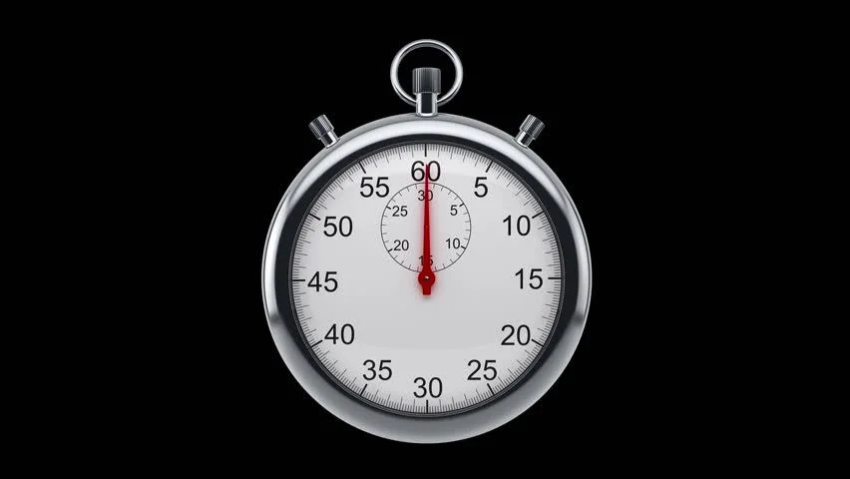
LOGISTIC REGRESSION VS MLP: Speed
Compared to Logistic Regression, MLP is:
80x slower for training (not including resampling)
130x slower for predicting
Notes:
We’re talking fractions of a second compared to a second or two, but this something to consider.

Slide 18
LOGISTIC REGRESSION VS MLP: Grooming
How does MLP perform without the Grooming feature?
Context: Excessive grooming emerged as one of the most influential predictors in Cat-pstone 1.
Notes:
add that in order to assess excessive grooming for the current model, you had to add more work to the kennel staff, which is already swamped with responsibilities.

Slide 19
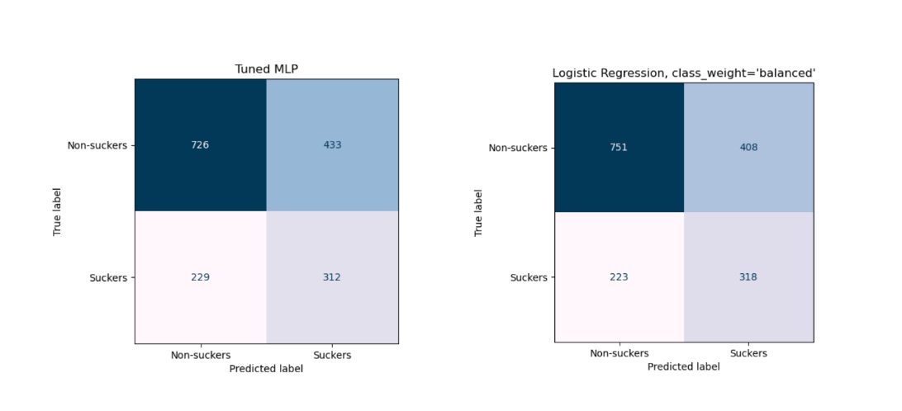
LOGISTIC REGRESSION VS MLP: Grooming
Notes:
Expectation: MLP was anticipated to outperform logistic regression, even without the inclusion of the highly predictive excessive grooming feature.
Reality Check: Contrary to our expectations, both MLP and logistic regression models yielded comparable performance without incorporating the grooming feature.
Surprising Finding: The exclusion of grooming did not significantly impact the predictive accuracy of either model.

Slide 20
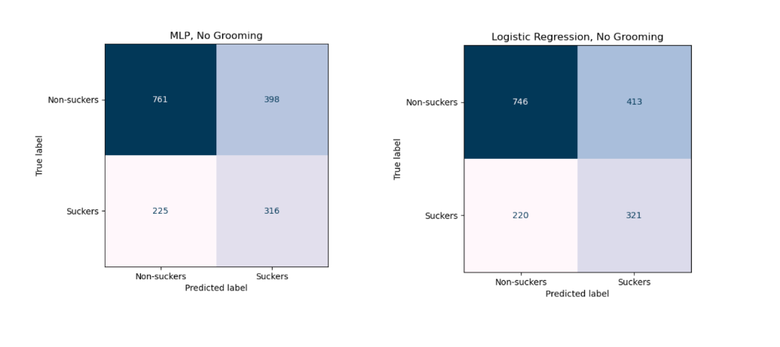
LOGISTIC REGRESSION VS MLP: No Grooming
Notes:
Expectation: MLP was anticipated to outperform logistic regression, even without the inclusion of the highly predictive excessive grooming feature.
Reality Check: Contrary to our expectations, both MLP and logistic regression models yielded comparable performance with and without incorporating the grooming feature.
Surprising Finding: The exclusion of grooming did not significantly impact the predictive accuracy of either model.

Slide 21
RECAP AND RECOMMENDATIONS

Slide 22
RECAP AND RECOMMENDATIONS
Deep learning (MLP) is impractical for this use-case; logistic regression is preferred due to its efficiency.
Logistic regression is faster in data preparation, model fitting, and prediction.
Refine the model's feature set through further research and and analyze the grooming feature's influence.

